Slide 1
Analysis of US and Japan Video Game Markets
OBri Games inquiry and analysis

Slide 2

Overview and problem statement
Currently only selling games in North America
Should we expand to Japanese market?
Is there a significant difference in sales?

Slide 3
Data analyzed
Approximately 16,719 different video games
Data includes sales in North America and Japan.
Raw data available here (gathered from Kaggle)

Slide 4

Marketing and sales focus:
North America vs Japan

Slide 5
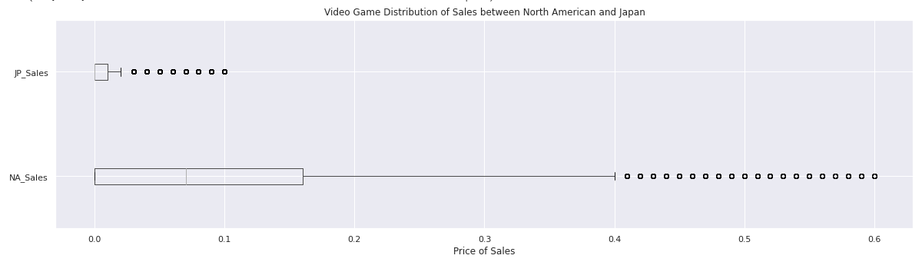
Statistically significant difference between North American and Japan Sales:
The median price of sales in North America was $0.07 higher than Japan.
Higher prices in North America
Max $41.36 (NA) vs $10.22 (JP)
Notes:
.

Slide 6
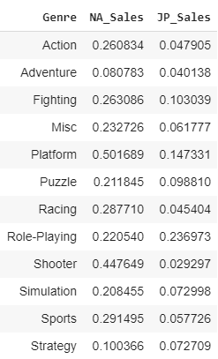
Stay focused
Stay focused on North American Markets
Look for additional opportunities with a focus on genres
Mean sales across genres

Slide 7
Questions?

Slide 8
Thank you

